Slide 1
Data Mining in Artificial Intelligence:
Decision Trees
Notes:
Lecture 1

Slide 2
Outline
Introduction: Data Flood
Top-Down Decision Tree Construction
Choosing the Splitting Attribute
Information Gain and Gain Ratio
Pruning

Slide 3
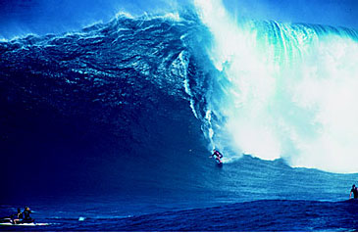
Trends leading to Data Flood
More data is generated:
  Bank, telecom, other business transactions ...
  Scientific Data: astronomy, biology, etc
  Web, text, and e-commerce

Slide 4
Data Growth
Large DB examples as of 2003:
  France Telecom has largest decision-support DB, ~30TB; AT&T ~ 26 TB
  Alexa internet archive: 7 years of data, 500 TB
  Google searches 3.3 Billion pages, ? TB
Twice as much information was created in 2002 as in 1999 (~30% growth rate)
Knowledge Discovery is NEEDED to make sense and use of data.

Slide 5
Machine Learning / Data Mining
Application areas
Science
  astronomy, bioinformatics, drug discovery, …
Business
  advertising, CRM (Customer Relationship management), investments, manufacturing, sports/entertainment, telecom, e-Commerce, targeted marketing, health care, …
Web:
  search engines, bots, …
Government
  law enforcement, profiling tax cheaters, anti-terror(?)

Slide 6
Assessing Credit Risk: Example
Situation: Person applies for a loan
Task: Should a bank approve the loan?
Note: People who have the best credit don’t need the loans, and people with worst credit are not likely to repay. Bank’s best customers are in the middle

Slide 7
Credit Risk - Results
Banks develop credit models using variety of machine learning methods.
Mortgage and credit card proliferation are the results of being able to successfully predict if a person is likely to default on a loan
Widely deployed in many countries

Slide 8
DNA Microarrays – Example
Given microarray data for a number of samples (patients), can we
Accurately diagnose the disease?
Predict outcome for given treatment?
Recommend best treatment?

Slide 9
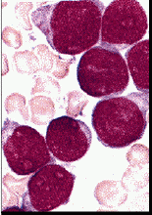

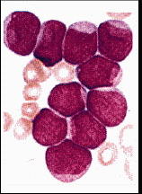
Example: ALL/AML Leukemia data
38 training cases, 34 test, ~ 7,000 genes
2 Classes: Acute Lymphoblastic Leukemia (ALL) vs Acute Myeloid Leukemia (AML)
Use train data to build diagnostic model
ALL
AML
  Results on test data better than human expert
  33/34 correct (1 error may be mislabeled)

Slide 10
Related Fields
Machine
Learning
Visualization
Data Mining and
Knowledge Discovery
Statistics
Databases

Slide 11
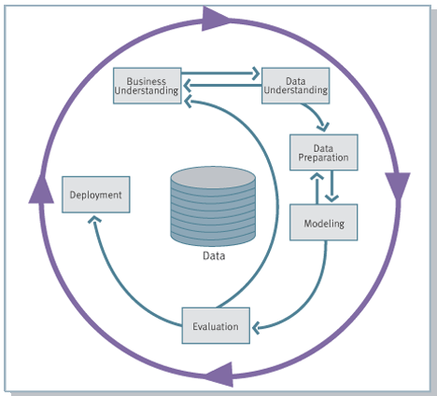
Knowledge Discovery Process flow, according to CRISP-DM
see
www.crisp-dm.org
for more
information
Monitoring

Slide 12
Major Data Mining Tasks
Classification: predicting an item class
Clustering: finding clusters in data
Associations: e.g. A & B & C occur frequently
Visualization: to facilitate human discovery
…

Slide 13
Data Mining Tasks: Classification
Learn a method for predicting the instance class from pre-labeled (classified) instances
Many approaches: Statistics,
Decision Trees, Neural Networks,
...

Slide 14
DECISION TREE
An internal node is a test on an attribute.
A branch represents an outcome of the test, e.g., Color=red.
A leaf node represents a class label or class label distribution.
At each node, one attribute is chosen to split training examples into distinct classes as much as possible
A new case is classified by following a matching path to a leaf node.

Slide 15
Weather Data: Play or not Play?
Outlook | Temperature | Humidity | Windy | Play?
sunny | hot | high | false | No
sunny | hot | high | true | No
overcast | hot | high | false | Yes
rain | mild | high | false | Yes
rain | cool | normal | false | Yes
rain | cool | normal | true | No
overcast | cool | normal | true | Yes
sunny | mild | high | false | No
sunny | cool | normal | false | Yes
rain | mild | normal | false | Yes
sunny | mild | normal | true | Yes
overcast | mild | high | true | Yes
overcast | hot | normal | false | Yes
rain | mild | high | true | No
Note:
Outlook is the
Forecast,
no relation to
Microsoft
email program

Slide 16
Example Tree for “Play?”
Outlook
sunny
overcast
rain
Humidity
Yes
Windy
high
normal
true
false
No
Yes
No
Yes

Slide 17
Building Decision Tree [Q93]
Top-down tree construction
  At start, all training examples are at the root.
  Partition the examples recursively by choosing one attribute each time.
Bottom-up tree pruning
  Remove subtrees or branches, in a bottom-up manner, to improve the estimated accuracy on new cases.

Slide 18
Choosing the Splitting Attribute
At each node, available attributes are evaluated on the basis of separating the classes of the training examples. A Goodness function is used for this purpose.
Typical goodness functions:
  information gain (ID3/C4.5)
  information gain ratio
  gini index

Slide 19
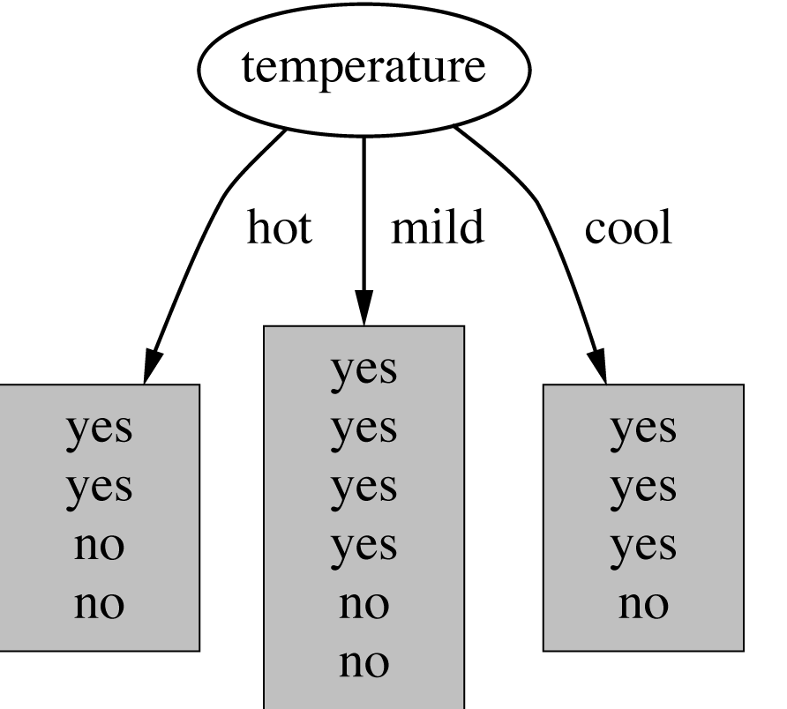
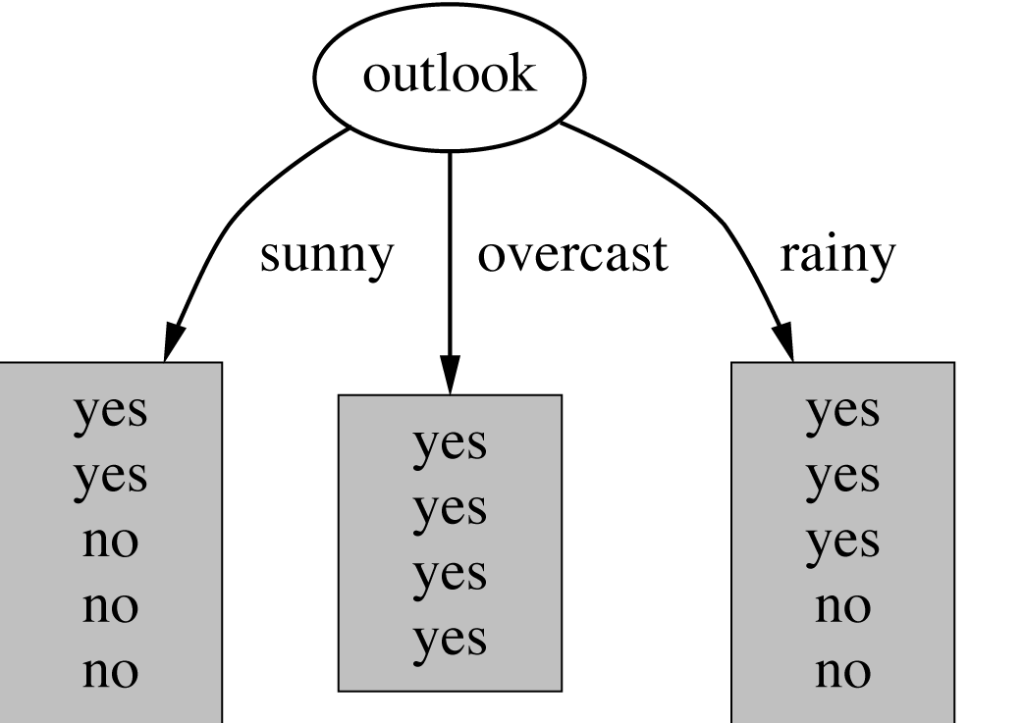
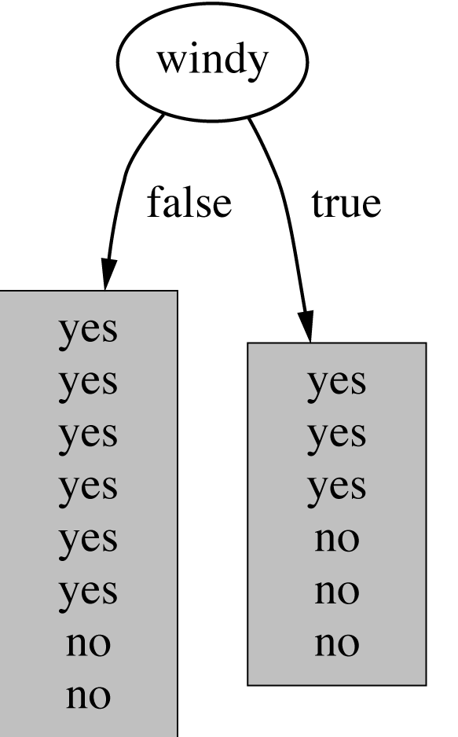
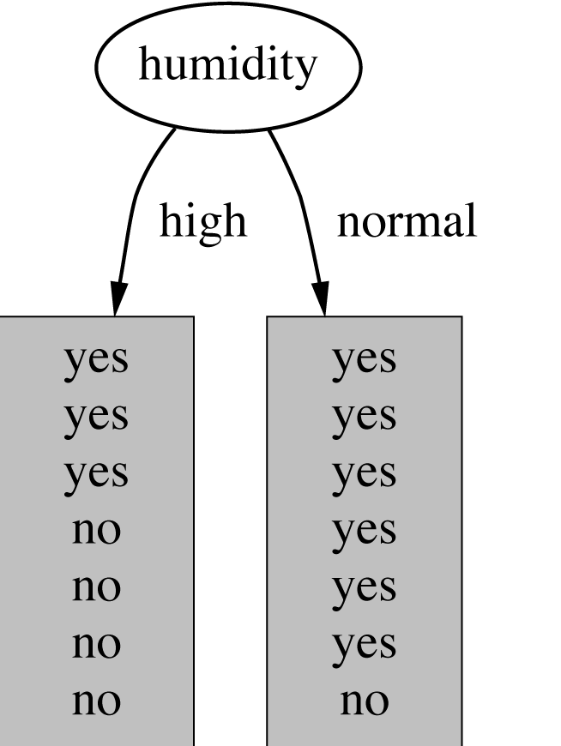
Which attribute to select?

Slide 20
A criterion for attribute selection
Which is the best attribute?
  The one which will result in the smallest tree
  Heuristic: choose the attribute that produces the “purest” nodes
Popular impurity criterion: information gain
  Information gain increases with the average purity of the subsets that an attribute produces
Strategy: choose attribute that results in greatest information gain

Slide 21
Computing information
Information is measured in bits
  Given a probability distribution, the info required to predict an event is the distribution’s entropy
  Entropy gives the information required in bits (this can involve fractions of bits!)

Slide 22
Entropy
Formula for computing the entropy:

Slide 23
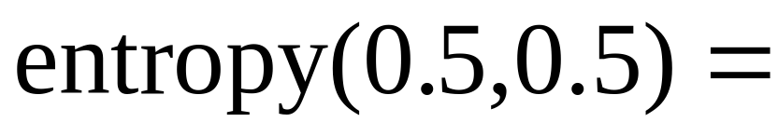
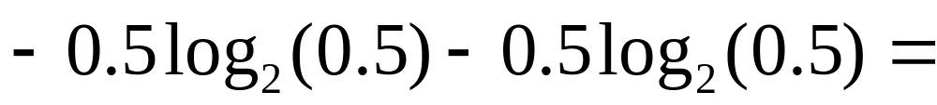
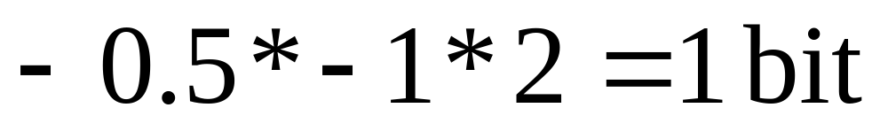
Example: fair coin throw
P (head) = 0.5
P (tail) = 0.5

Slide 24
Example: biased coin throw
P(head) | 0.5 | 0.25 | 0.1 | 0
P(tail) | 0.5 | 0.75 | 0.9 | 1
Entropy | 1 | 0.811 | 0.469 | 0.000

Slide 25
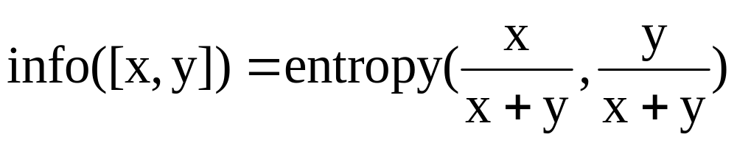
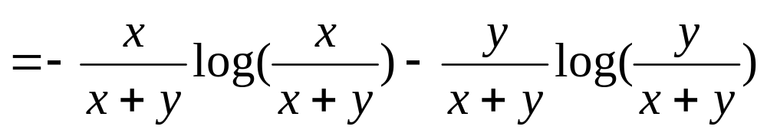
Entropy of a split
Information in a split with x items of one class, y items of the second class

Slide 26
Example: attribute “Outlook”
“Outlook” = “Sunny”: 2 and 3 split

Slide 27
Outlook = Overcast
“Outlook” = “Overcast”: 4/0 split
Note: log(0) is not defined, but we evaluate 0*log(0) as zero

Slide 28
Outlook = Rainy
“Outlook” = “Rainy”:

Slide 29

Expected Information
Expected information for attribute:

Slide 30


Computing the information gain
Information gain:
(information before split) – (information after split)
Information gain for attributes from weather data:

Slide 31
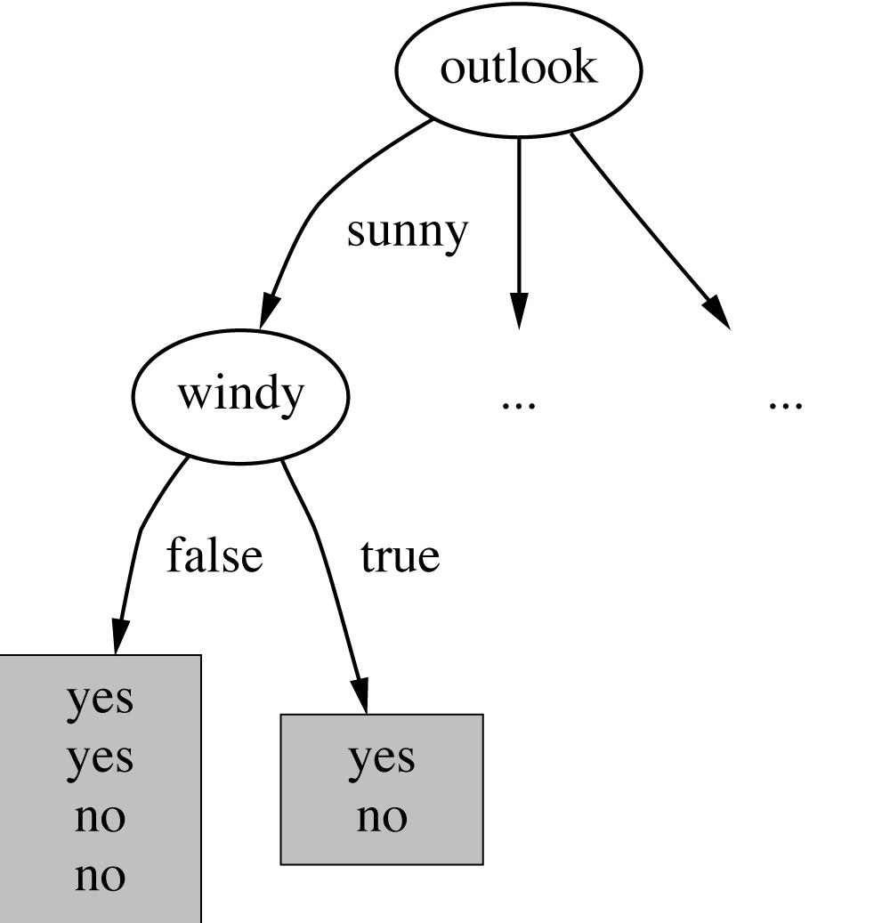
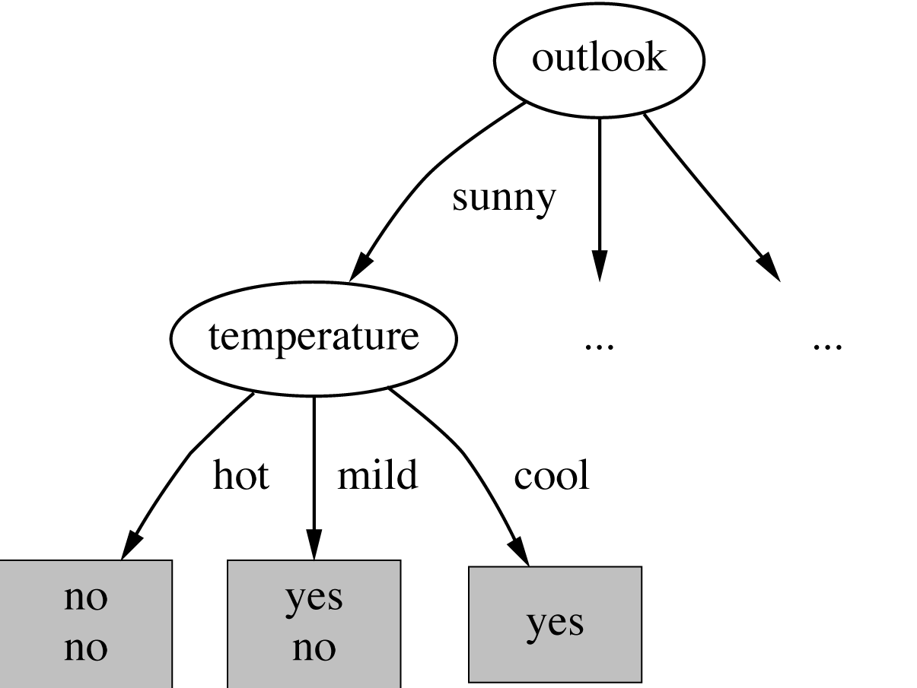
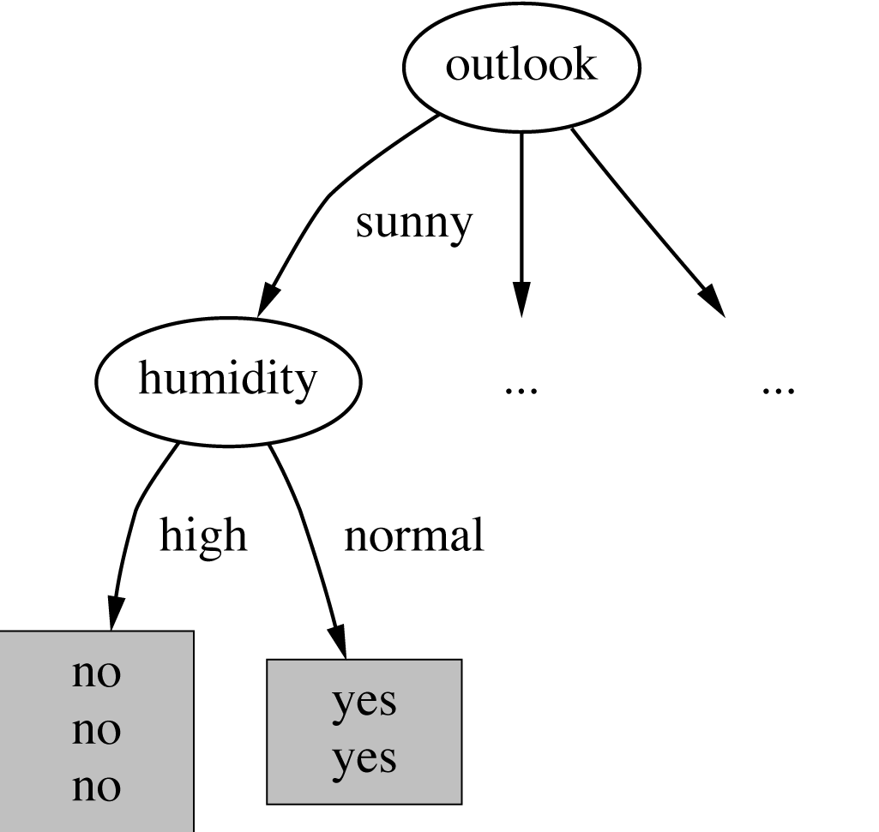

Continuing to split

Slide 32
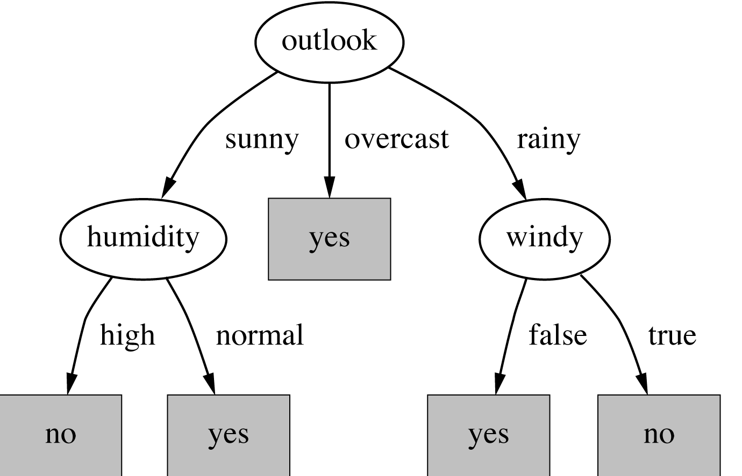
The final decision tree
Note: not all leaves need to be pure; sometimes identical instances have different classes
  ⇒ Splitting stops when data can’t be split any further

Slide 33
Highly-branching attributes
Problematic: attributes with a large number of values (extreme case: ID code)
Subsets are more likely to be pure if there is a large number of values
  Information gain is biased towards choosing attributes with a large number of values
  This may result in overfitting (selection of an attribute that is non-optimal for prediction)

Slide 34
Weather Data with ID code
ID | Outlook | Temperature | Humidity | Windy | Play?
A | sunny | hot | high | false | No
B | sunny | hot | high | true | No
C | overcast | hot | high | false | Yes
D | rain | mild | high | false | Yes
E | rain | cool | normal | false | Yes
F | rain | cool | normal | true | No
G | overcast | cool | normal | true | Yes
H | sunny | mild | high | false | No
I | sunny | cool | normal | false | Yes
J | rain | mild | normal | false | Yes
K | sunny | mild | normal | true | Yes
L | overcast | mild | high | true | Yes
M | overcast | hot | normal | false | Yes
N | rain | mild | high | true | No

Slide 35
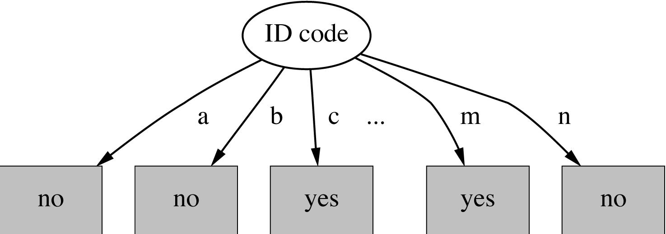
Split for ID Code Attribute
Entropy of split = 0 (since each leaf node is “pure”, having only
one case.
Information gain is maximal for ID code

Slide 36
Gain ratio
Gain ratio: a modification of the information gain that reduces its bias on high-branch attributes
Gain ratio should be
  Large when data is evenly spread
  Small when all data belong to one branch
Gain ratio takes number and size of branches into account when choosing an attribute
  It corrects the information gain by taking the intrinsic information of a split into account (i.e. how much info do we need to tell which branch an instance belongs to)

Slide 37
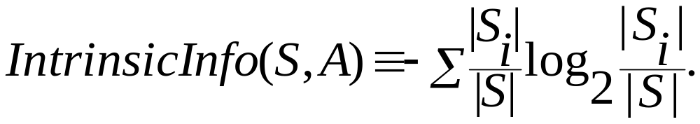
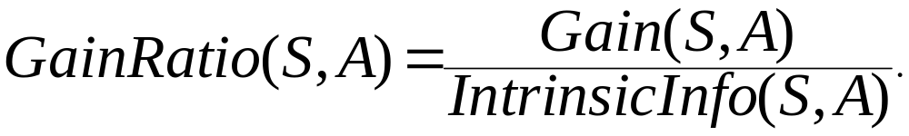
Gain Ratio and Intrinsic Info.
Intrinsic information: entropy of distribution of instances into branches
Gain ratio (Quinlan’86) normalizes info gain by:

Slide 38
Gain ratios for weather data
Outlook |  | Temperature
Info: | 0.693 | Info: | 0.911
Gain: 0.940-0.693 | 0.247 | Gain: 0.940-0.911 | 0.029
Split info: info([5,4,5]) | 1.577 | Split info: info([4,6,4]) | 1.362
Gain ratio: 0.247/1.577 | 0.156 | Gain ratio: 0.029/1.362 | 0.021
Humidity |  | Windy
Info: | 0.788 | Info: | 0.892
Gain: 0.940-0.788 | 0.152 | Gain: 0.940-0.892 | 0.048
Split info: info([7,7]) | 1.000 | Split info: info([8,6]) | 0.985
Gain ratio: 0.152/1 | 0.152 | Gain ratio: 0.048/0.985 | 0.049

Slide 39
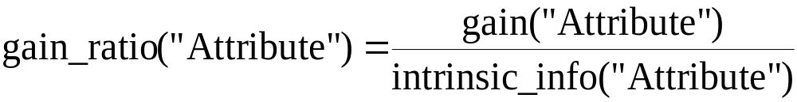
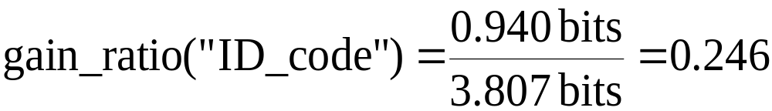
*Computing the gain ratio
Example: intrinsic information for ID code
Importance of attribute decreases as intrinsic information gets larger
Example of gain ratio:
Example:

Slide 40
*More on the gain ratio
“Outlook” still comes out top
However: “ID code” has greater gain ratio
  Standard fix: manually exclude ID-type fields
Problem with gain ratio: it may overcompensate
  May choose an attribute just because its intrinsic information is very low
  Standard fix:
    First, only consider attributes with greater than average information gain
    Then, compare them on gain ratio

Slide 41
*C4.5 History
ID3, CHAID – 1960s
C4.5 innovations (Quinlan):
  permit numeric attributes
  deal sensibly with missing values
  pruning to deal with for noisy data
C4.5 - one of best-known and most widely-used learning algorithms
  Last research version: C4.8, implemented in Weka as J4.8 (Java)
  Commercial successor: C5.0 (available from Rulequest)

Slide 42
Industrial-strength algorithms
For an algorithm to be useful in a wide range of real-world applications it must:
  Permit numeric attributes
  Allow missing values
  Be robust in the presence of noise
  Be able to approximate arbitrary concept descriptions (at least in principle)
Basic schemes need to be extended to fulfill these requirements

Slide 43
Numeric attributes
Standard method: binary splits
  E.g. temp < 45
Unlike nominal attributes,
every attribute has many possible split points
Solution is straightforward extension:
  Evaluate info gain (or other measure)
  for every possible split point of attribute
  Choose “best” split point
  Info gain for best split point is info gain for attribute
Computationally more demanding

Slide 44
Weather data - numeric
Outlook | Temperature | Humidity | Windy | Play
Sunny | 85 | 85 | False | No
Sunny | 80 | 90 | True | No
Overcast | 83 | 86 | False | Yes
Rainy | 75 | 80 | False | Yes
… | … | … | … | …
If outlook = sunny and humidity > 83 then play = no If outlook = rainy and windy = true then play = no If outlook = overcast then play = yes If humidity < 85 then play = yes If none of the above then play = yes

Slide 45
Example
Split on temperature attribute:
  E.g. temperature < 71.5: yes/4, no/2
  temperature ≥ 71.5: yes/5, no/3
  Info([4,2],[5,3])
  = 6/14 info([4,2]) + 8/14 info([5,3])
  = 0.939 bits
Place split points halfway between values
Can evaluate all split points in one pass!
64 65 68 69 70 71 72 72 75 75 80 81 83 85 Yes No Yes Yes Yes No No Yes Yes Yes No Yes Yes No

Slide 46
Speeding up
Entropy only needs to be evaluated between points of different classes (Fayyad & Irani, 1992)
value
class
64 65 68 69 70 71 72 72 75 75 80 81 83 85 Yes No Yes Yes Yes No No Yes Yes Yes No Yes Yes No
X
Potential optimal breakpoints
Breakpoints between values of the same class cannot
be optimal

Slide 47
Missing values
Missing value denoted “?” in C4.X
Simple idea: treat missing as a separate value
Q: When this is not appropriate?
  When values are missing due to different reasons
  Example: field IsPregnant=missing for a male patient should be treated differently (no) than for a female patient of age 25 (unknown)

Slide 48
Missing values - advanced
Split instances with missing values into pieces
  A piece going down a branch receives a weight proportional to the popularity of the branch
  weights sum to 1
Info gain works with fractional instances
  use sums of weights instead of counts
During classification, split the instance into pieces in the same way
  Merge probability distribution using weights

Slide 49
Pruning
Goal: Prevent overfitting to noise in the data
Two strategies for “pruning” the decision tree:
  Postpruning - take a fully-grown decision tree and discard unreliable parts
  Prepruning - stop growing a branch when information becomes unreliable
Postpruning preferred in practice—prepruning can “stop too early”

Slide 50
Prepruning
Based on statistical significance test
  Stop growing the tree when there is no statistically significant association between any attribute and the class at a particular node
Most popular test: chi-squared test
ID3 used chi-squared test in addition to information gain
  Only statistically significant attributes were allowed to be selected by information gain procedure

Slide 51
Early stopping
 | a | b | class
1 | 0 | 0 | 0
2 | 0 | 1 | 1
3 | 1 | 0 | 1
4 | 1 | 1 | 0
Pre-pruning may stop the growth process prematurely: early stopping
Classic example: XOR/Parity-problem
  No individual attribute exhibits any significant association to the class
  Structure is only visible in fully expanded tree
  Pre-pruning won’t expand the root node
But: XOR-type problems rare in practice
And: pre-pruning faster than post-pruning

Slide 52
Post-pruning
First, build full tree
Then, prune it
  Fully-grown tree shows all attribute interactions
Problem: some subtrees might be due to chance effects
Two pruning operations:
  Subtree replacement
  Subtree raising
Possible strategies:
  error estimation
  significance testing
  MDL principle

Slide 53
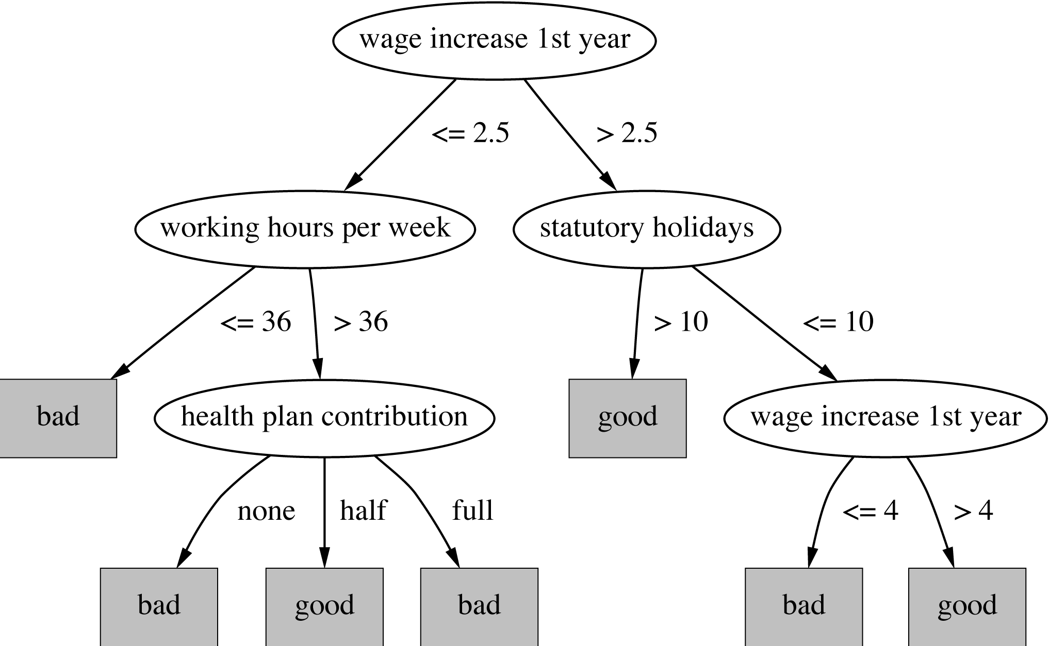
Subtree replacement
Bottom-up
Consider replacing a tree only after considering all its subtrees
Ex: labor negotiations

Slide 54
Subtree replacement, 2

Slide 55
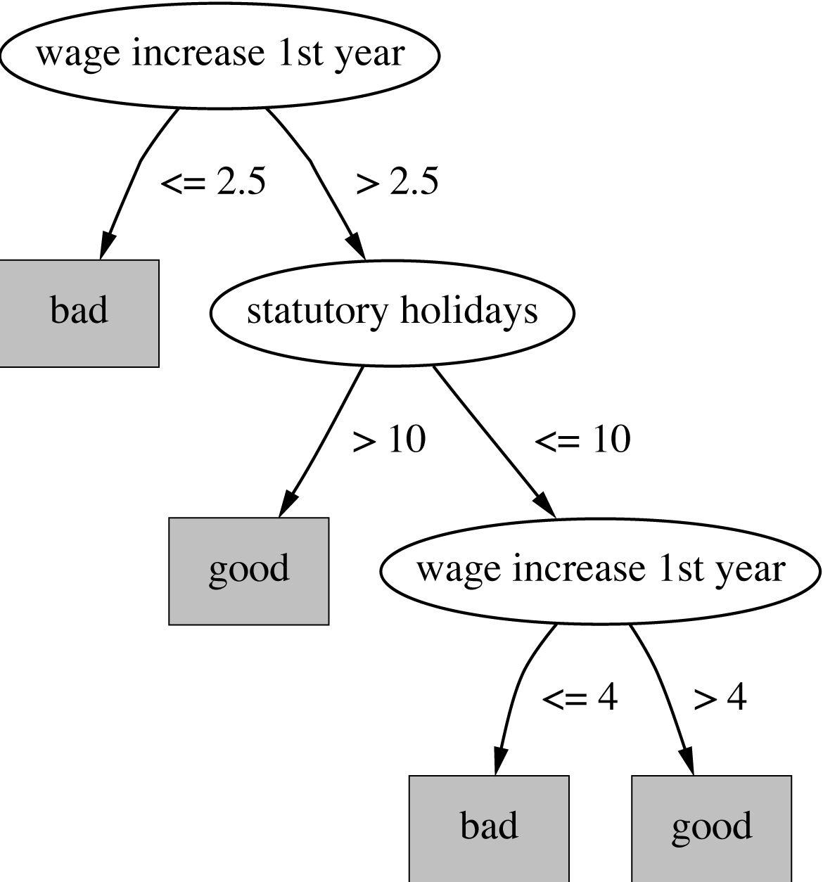
Subtree replacement, 3

Slide 56
Estimating error rates
Prune only if it reduces the estimated error
Error on the training data is NOT a useful estimator Q: Why?
A: it would result in very little pruning, because decision tree was built on the same training data
Use hold-out set for pruning
(“reduced-error pruning”)
C4.5’s method
  Derive confidence interval from training data
  Use a heuristic limit, derived from this, for pruning
  Shaky statistical assumptions (based on training data)
  Seems to work OK in practice

Slide 57
From trees to rules
Simple way: one rule for each leaf
C4.5rules: greedily prune conditions from each rule if this reduces its estimated error
  Can produce duplicate rules
  Check for this at the end
Then
  look at each class in turn
  consider the rules for that class
  find a “good” subset (guided by MDL)
Then rank the subsets to avoid conflicts
Finally, remove rules (greedily) if this decreases error on the training data

Slide 58
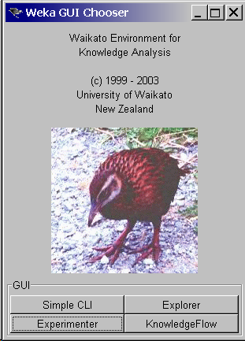
WEKA – Machine Learning and Data Mining Workbench
J4.8 – Java implementation
of C4.8
Many more decision-tree and
other machine learning methods

Slide 59
Summary
Decision Trees
  splits – binary, multi-way
  split criteria – information gain, gain ratio
  missing value treatment
  pruning
  rule extraction from trees

